Slide 1
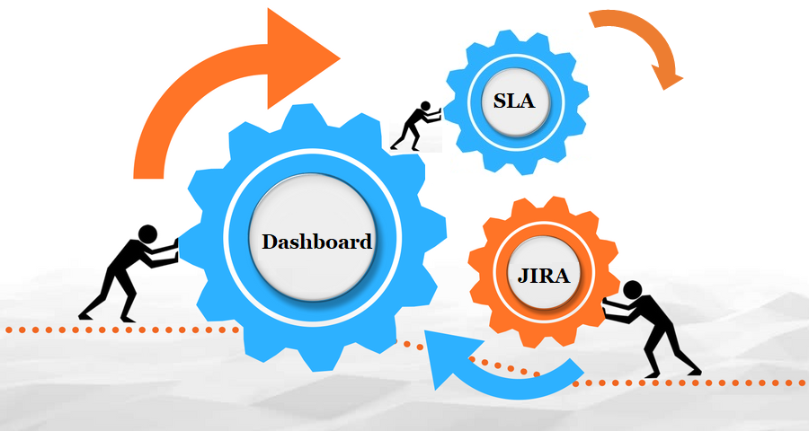
SLA DASHBOARD

Slide 2

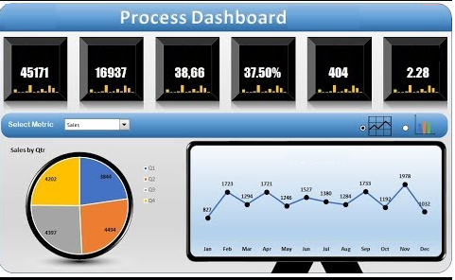

Work Flow
3. Middleware Admin
4. Resolve the Ticket
Deveops middleware Admin decides where the query has to go
Devops admin has to resolve the ticket with in 1 hour of time
2. Jira Story
Create a Jira story is basing upon the alert created by the team.
5. Report Generation
1. Alert
TL of the specific environment has to generate the report.
An Alert(Run scope) is created by the team

Slide 3



1. Alert
Tickets raised by the team are unanswered by the Middleware Admin team most of the time to avoid this.
An Alert (RunScope) is created so that team is aware of the know issues as well as the number of tickets raised.
Every Alert is registered along with it should be completed with in a time bound.

Slide 4

2. Jira Story
Jira story needs to be created once an Alert is raised by the team this is to ensure that the ticket is registered.
Once the Jira is created along with the ticket number and the alert is sent to the DEVOPS Middleware admin.

Slide 5

3. Middleware Admin
2. Application owner/Infra Team/Server team
1. Basing upon the JIRA created Devops Admin decides where exactly the ticket has to land
3. TL’s of the specific environment works on the Alert
Ensure that the ticket should be closed by the Devops Jira Admin with in 1 hour

Slide 6
4. Resolve the Ticket

All the tickets received to the TL of the specific environment need to be addressed

Tickets should be addressed and closed with in 1 hour.

Ensure that all the ticket completed with in the time and meets the SLA.

Slide 7


5. Report Generation
TL of the specific team ensures that all the tickets are addressed with in the specific time and generates a Report whether they are meeting the service levels.
Generates 5 reports in a week.

Slide 8
Report Automation
25%
50%
100%
Risk
Warning
Healthy
Collects the information of the server and runs the script.
Generates report automatically for every 15 minutes and provide the health status of the server.

